Slide 1
Sarah’s Jewelry Website

Slide 2
Are you looking for unique jewelry?
Can’t find something that is you?
Looking for a variety to choose from?

Slide 3
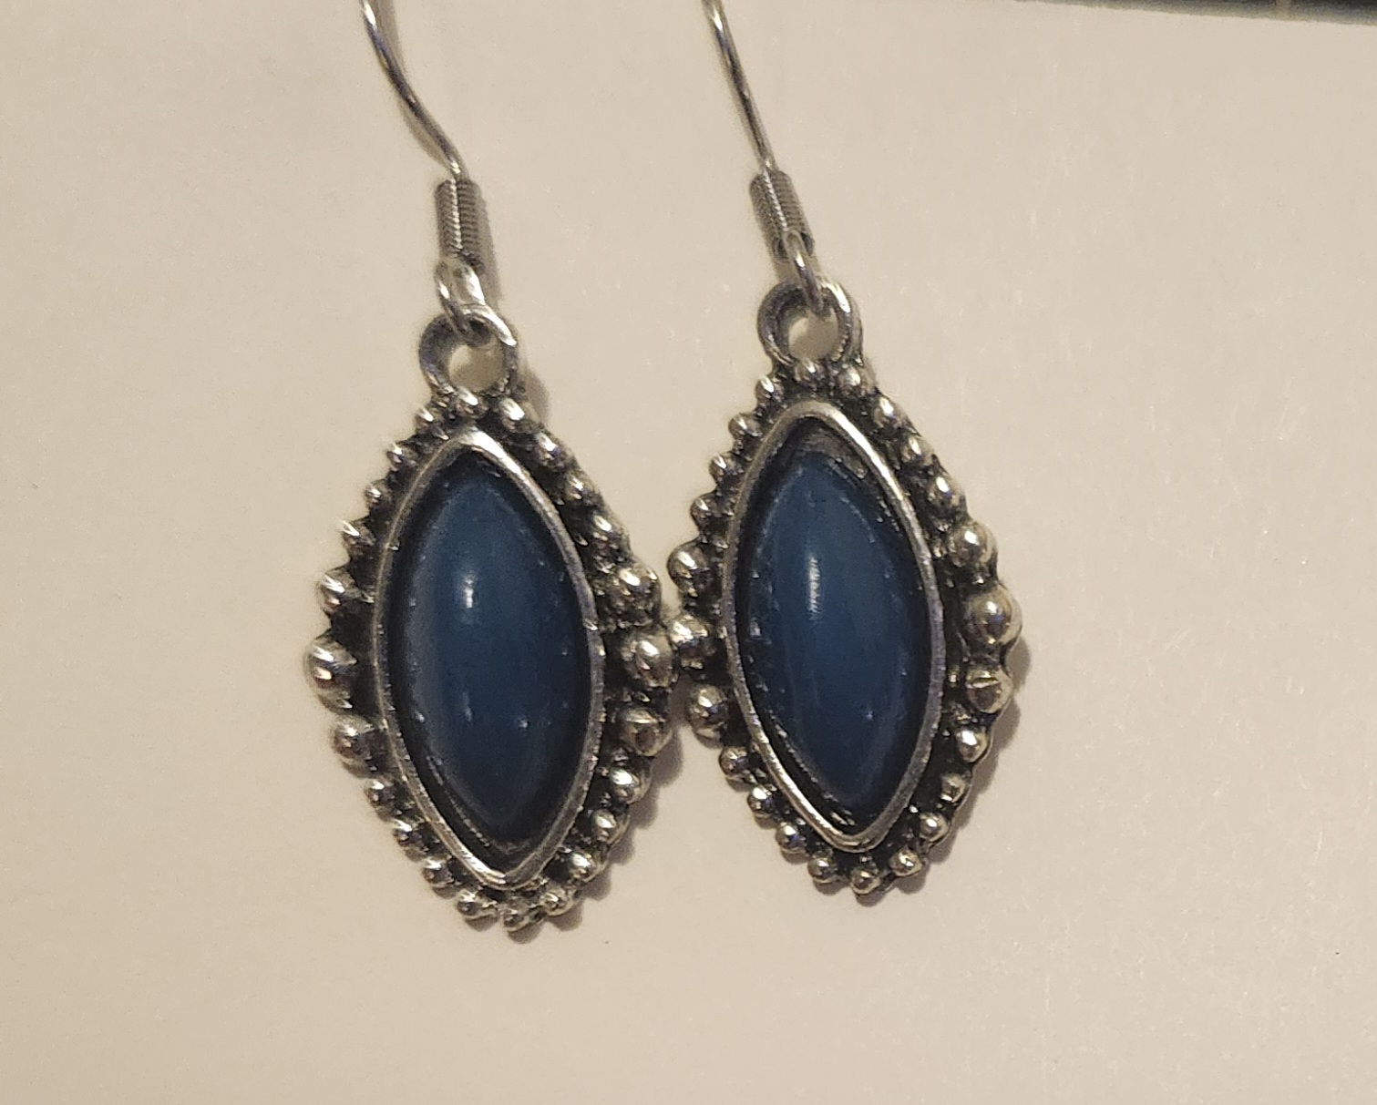
Simple Designs
Perfect for everyday
Add a touch that is you when you find the jewelry that speaks to you
All designs are available in necklaces and earrings
Unique Charm bracelets, not available in other stores

Slide 4
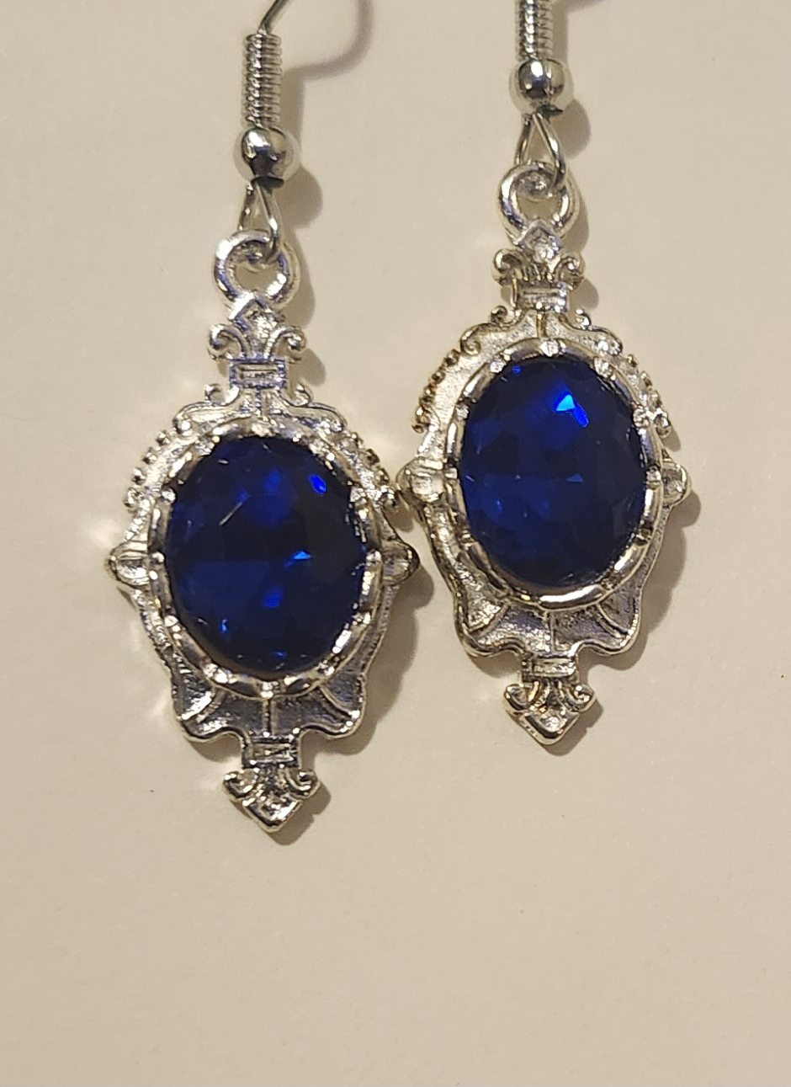
Elegant Designs
Looking for something a bit more elegant?
Gorgeous and unique

Slide 5
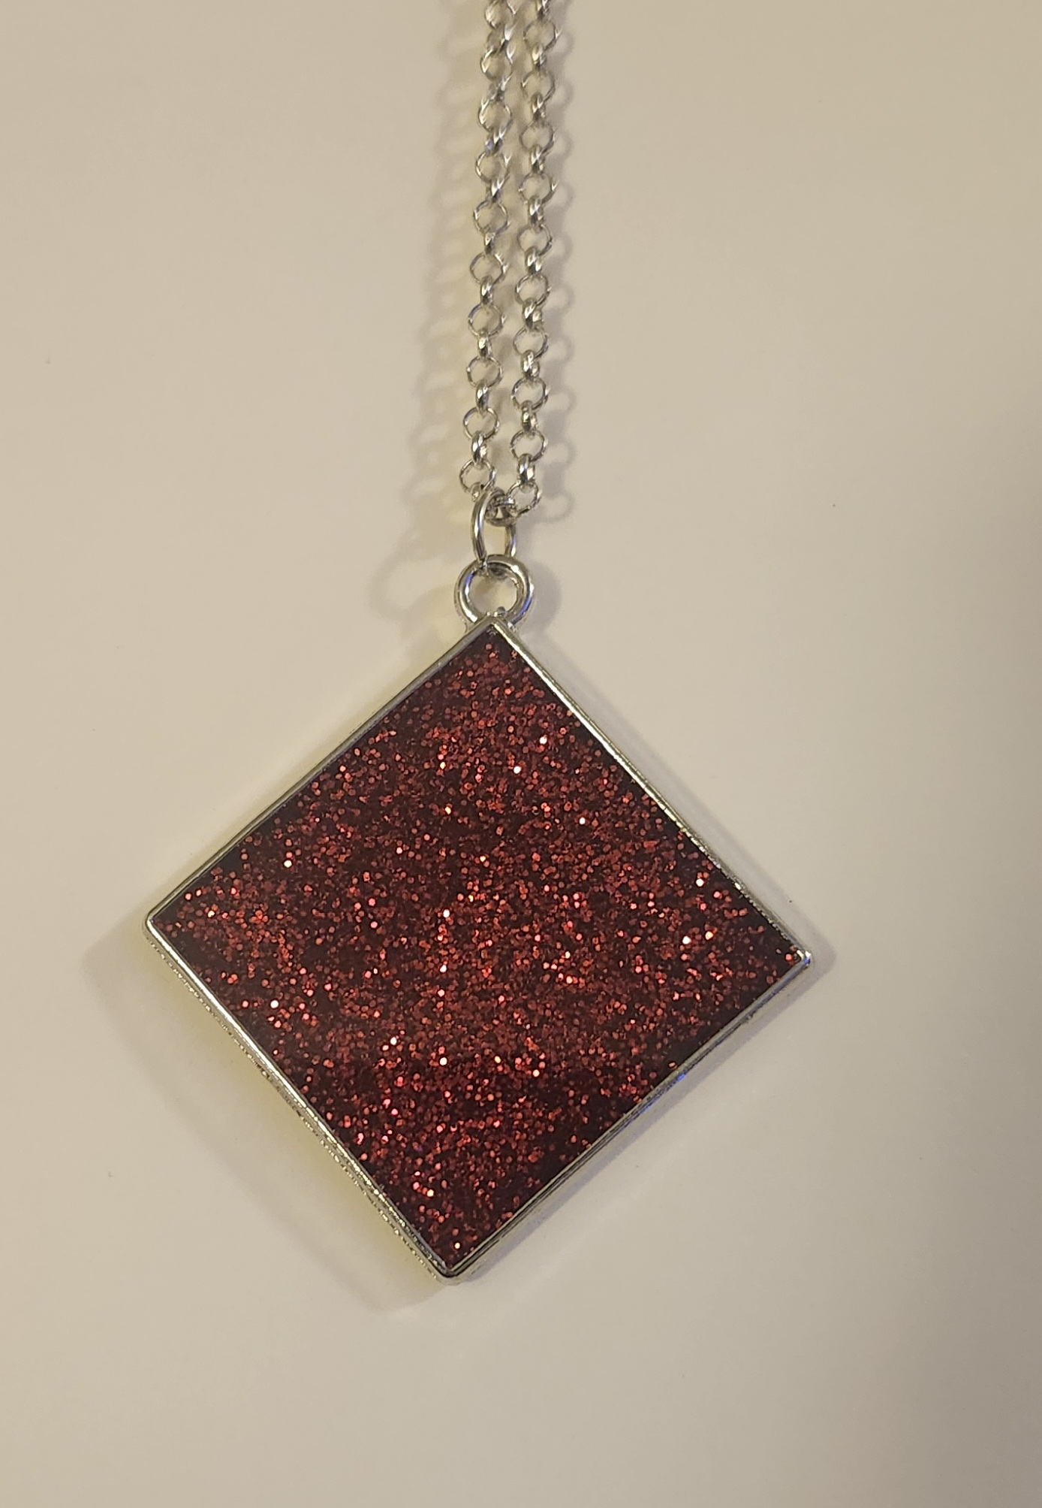
Unique Designs
Epoxy Resin Creations
Available in necklaces
Available in earrings

Slide 6
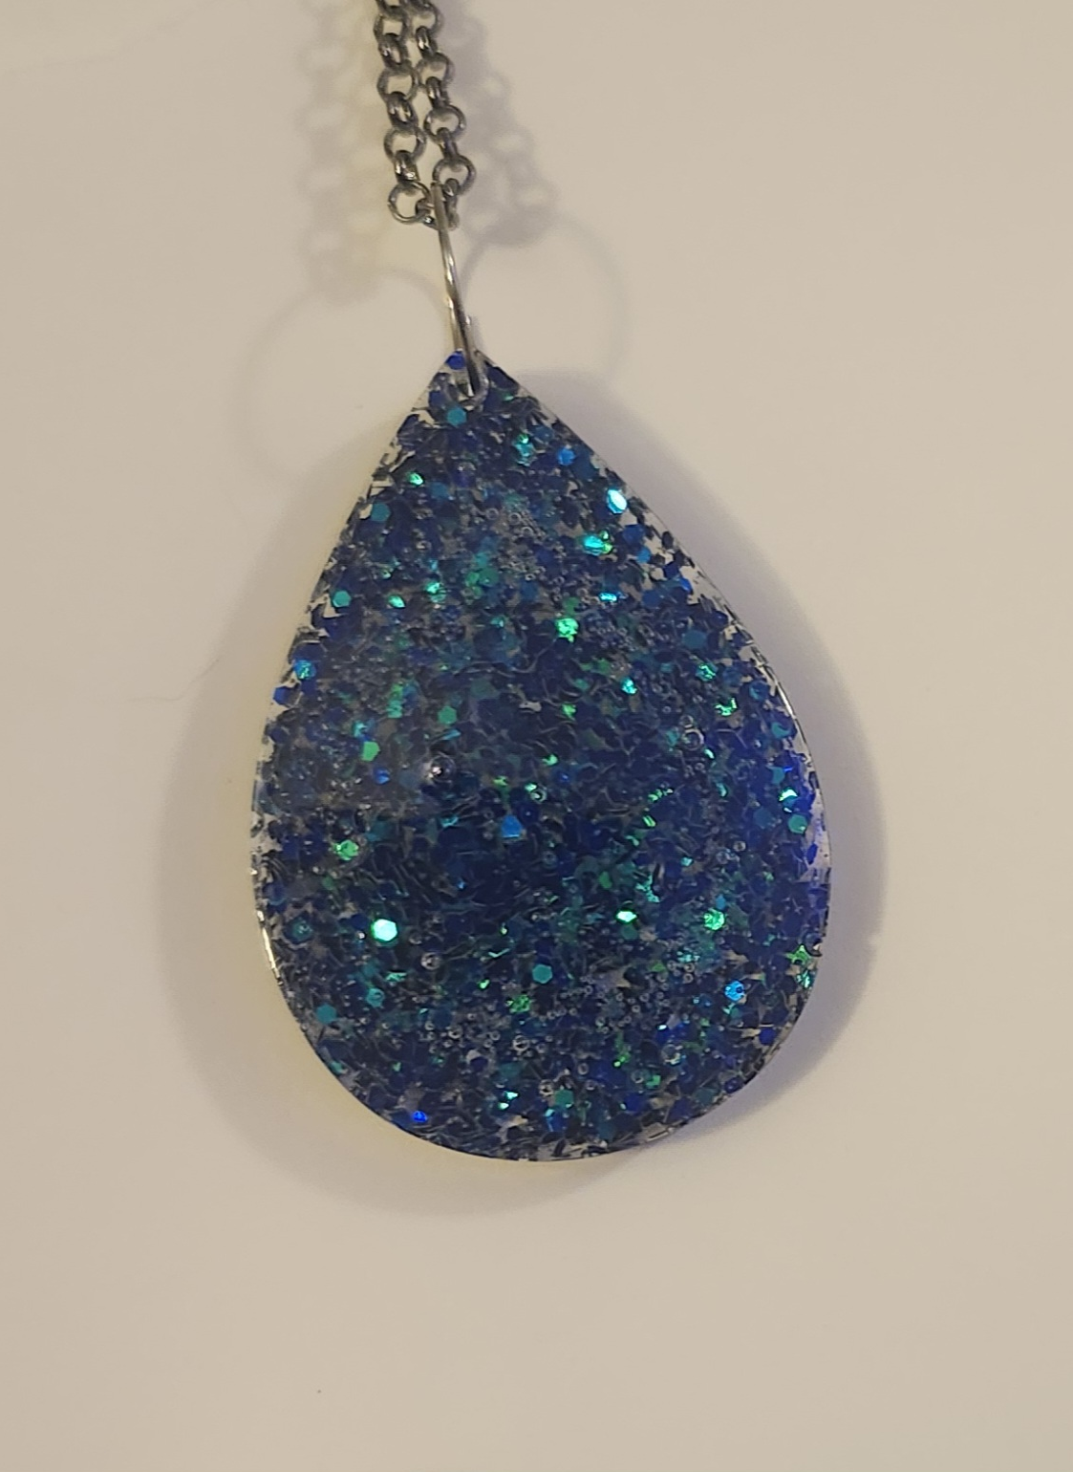
Multiple colors and shapes
Epoxy Resin Creations continued
Check out the selection

Slide 7
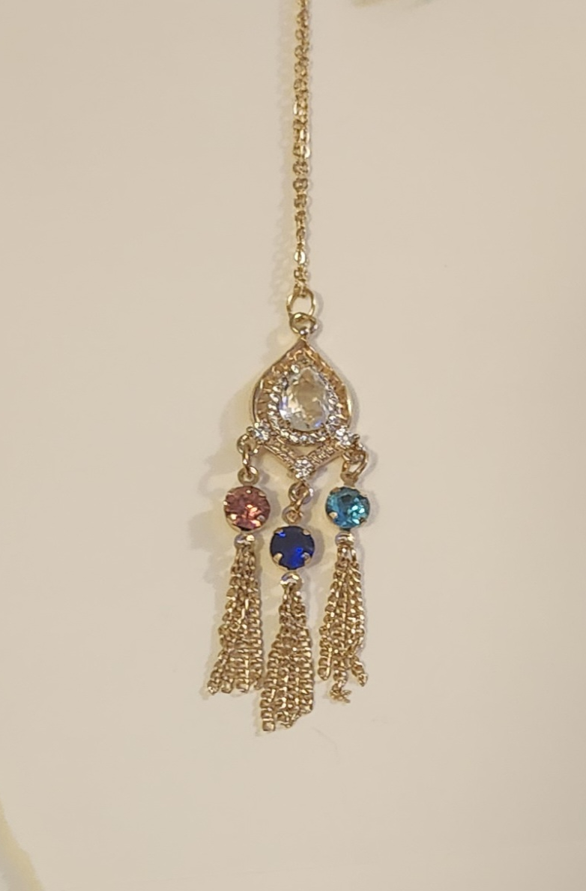
Beautiful Designs
All kinds of different charms and combinations
Multi-colored combinations
Completely unique jewelry made just for you

Slide 8
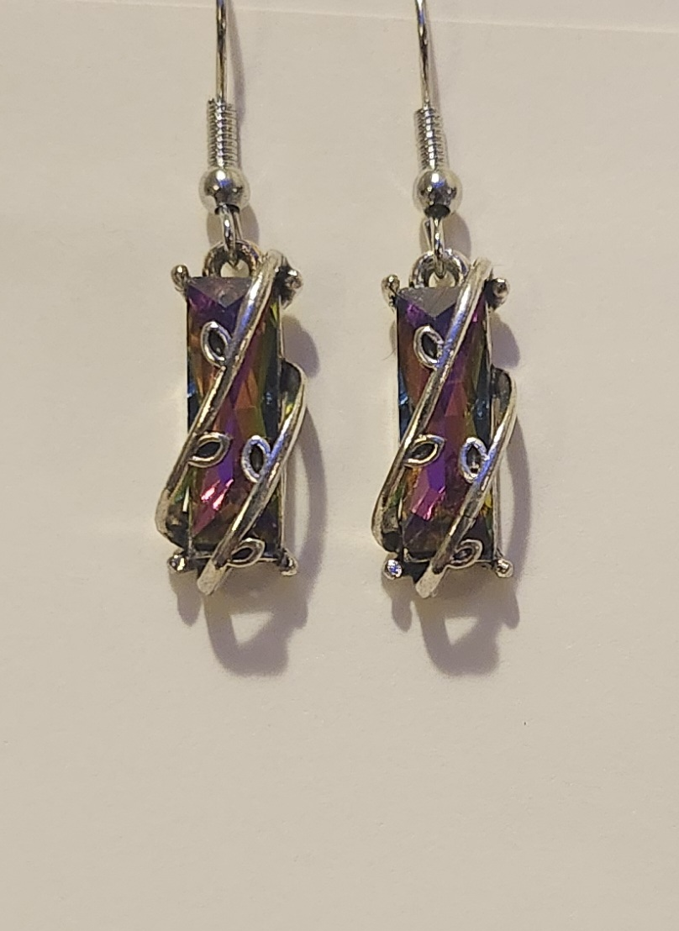
Delicate Designs
Intricate jewelry
Delicate features

Slide 9
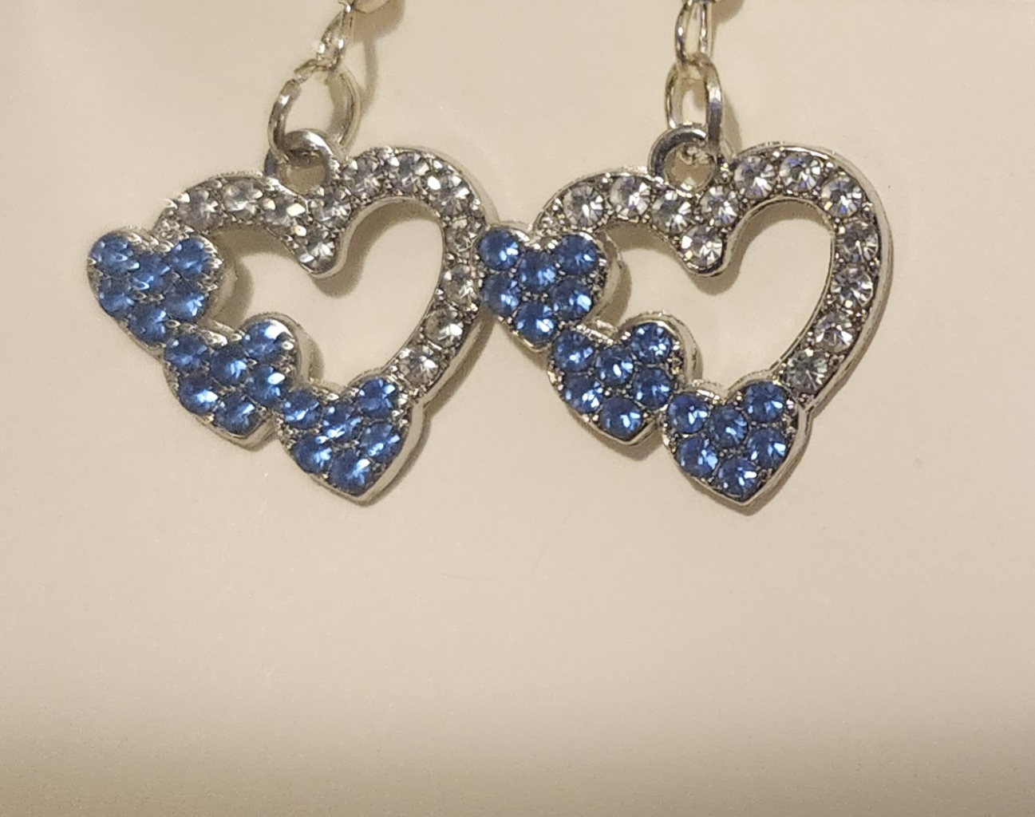
Special Occasions
Holiday jewelry
Romantic jewelry
Perfect for gifts or special occasions

Slide 10
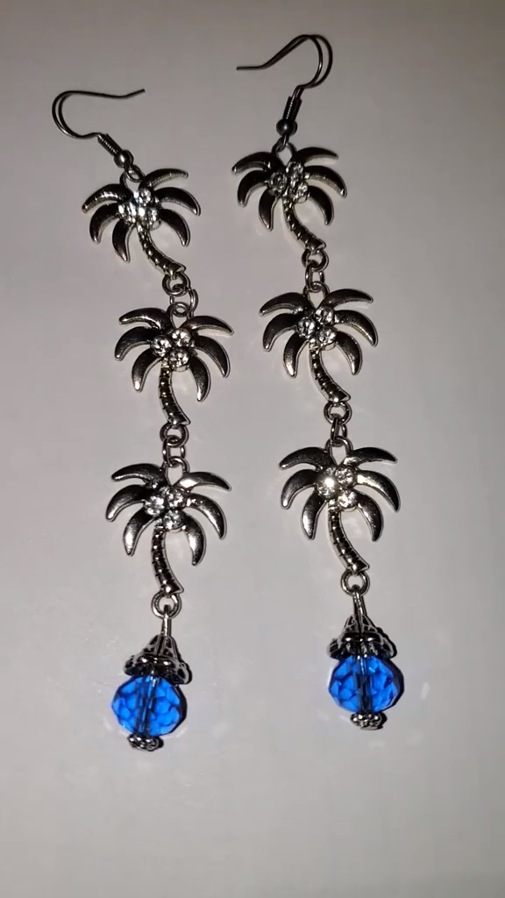
Wide variety of jewelry designs to choose from!

Slide 11
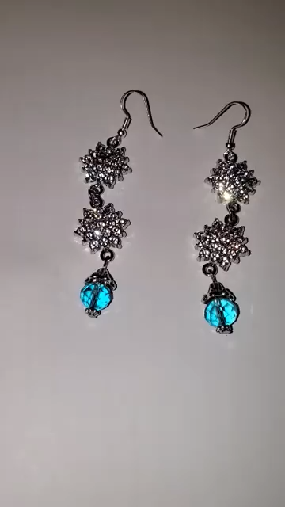
Unique combinations that you won’t find anywhere else!

